Slide 1

Google - Isolated Sign Language Recognition
— Enhance PopSign's educational games for learning ASL
Link: https://www.kaggle.com/code/weepcat/final
Github: https://github.com/Gracee2024/5642-final

Slide 2
Content
Background
Dataset Description
Exploratory Data Analysis
Model Building and Training
Results and Analysis

Slide 3
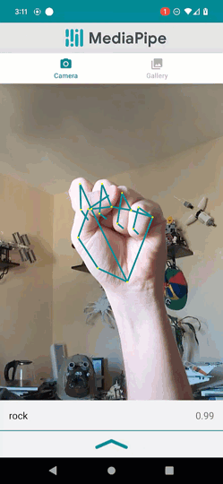
Background
Impact of Hearing Loss:
33 babies born with permanent hearing loss daily in the U.S.
90% born to hearing parents, many unfamiliar with American Sign Language (ASL).
Language Deprivation Syndrome:
Risk: Lack of early language exposure.
Consequences: Impacts relationships, education, and employment.
Challenges in Learning ASL:
Difficulty: Equivalent to learning a new language (e.g., Chinese).
Accessibility: Limited time and resources for parents.
Solution: PopSign App
Fun and Interactive: Matches ASL signs with English words.
Accessible: Smartphone-based learning tool.
The goal of this competition is to classify isolated American Sign Language (ASL) signs. The evaluation metric for this contest is simple classification accuracy

Slide 4
Content
Background
Dataset Description
Exploratory Data Analysis
Model Building and Training
Results and Analysis

Slide 5

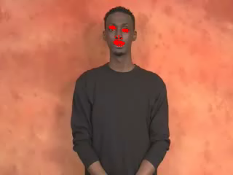
Dataset Description
Generated by Mediapipe on ~100k videos of isolated signs performed by 21 Deaf signers from a 250-sign vocabulary.
ASL is a visual-gestural language, meaning that it uses facial expressions, body language, and hand movements to convey meaning. We will have access to landmark data provided by Mediapipe for hands and face.
train.csv
Welcome
path: The path to the landmark file.
participant_id: A unique identifier for the data contributor.
sequence_id: A unique identifier for the landmark sequence.
sign: The label for the landmark sequence.
Files — train_landmark_files/[participant_id]/[sequence_id].parquet
frame: The frame number in the raw video.
row_id: A unique identifier for the row.
type: The type of landmark. One of ['face', 'left_hand', 'pose', 'right_hand’].
landmark_index: The landmark index number. Details of the hand landmark locations can be found here.
[x/y/z]: The normalized spatial coordinates of the landmark. These are the only columns that will be provided to your submitted model for inference.

Slide 6
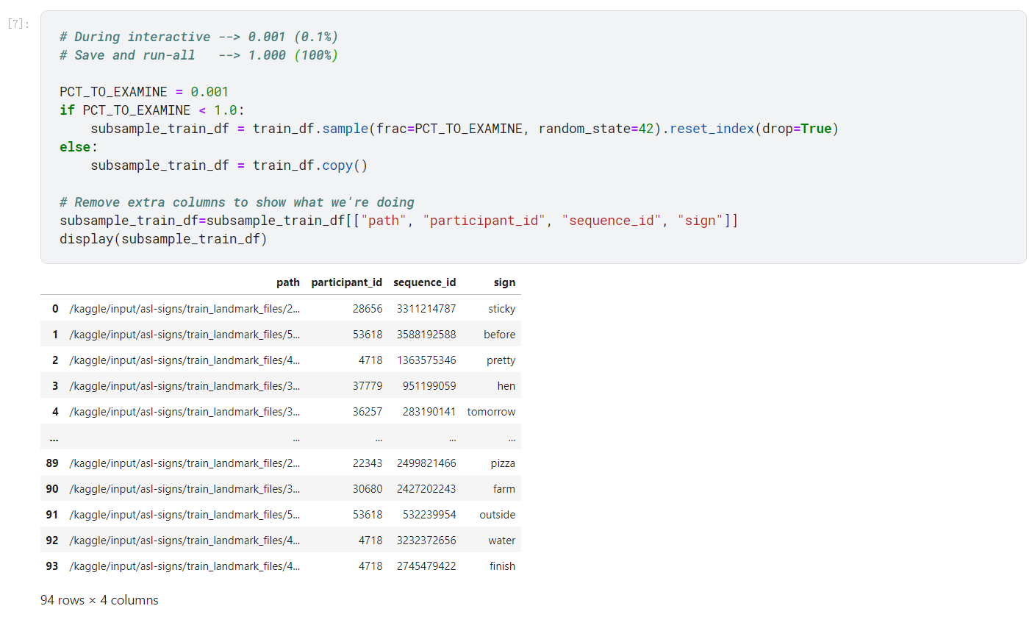
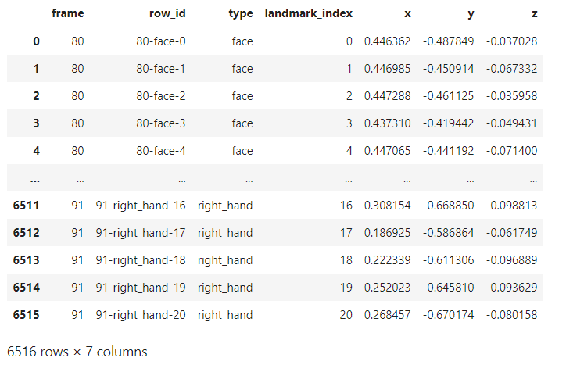
Content
Background
Dataset Description
Exploratory Data Analysis
Model Building and Training
Results and Analysis

Slide 7
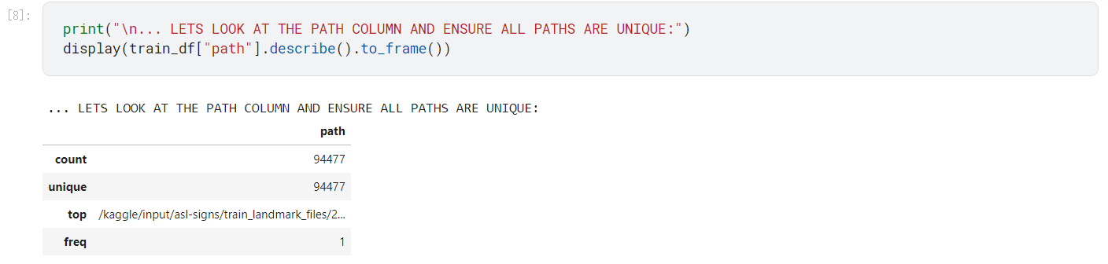
Examine the `path` Column
Every row and respective filepath is unique
Every path is comprised of.
The base part of the path --> /kaggle/input/asl-signs/train_landmark_files
The participant_id --> .../16069
The sequence_id as the parquet filename --> .../100015657.parquet

Slide 8
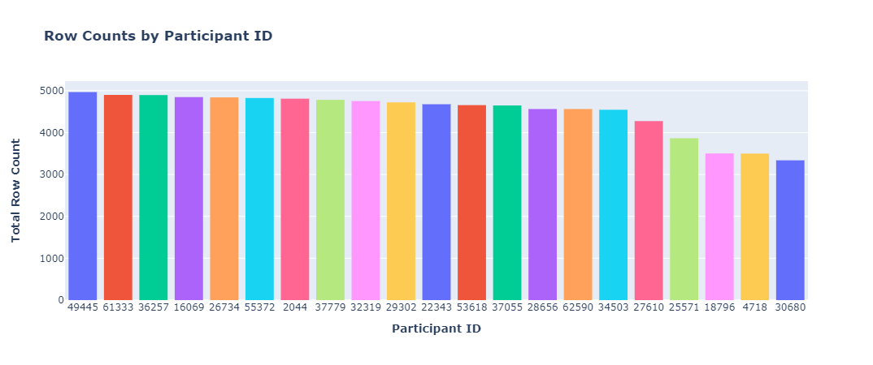
Examine the `participant_id` Column
Number Participants: 21
Average Number of Rows Per Participant: 4498.91
Standard Deviation in Counts Per Participant: 490.77
Minimum Number of Examples For One Participant: 3338
Maximum Number of Examples For One Participant: 4968

Slide 9
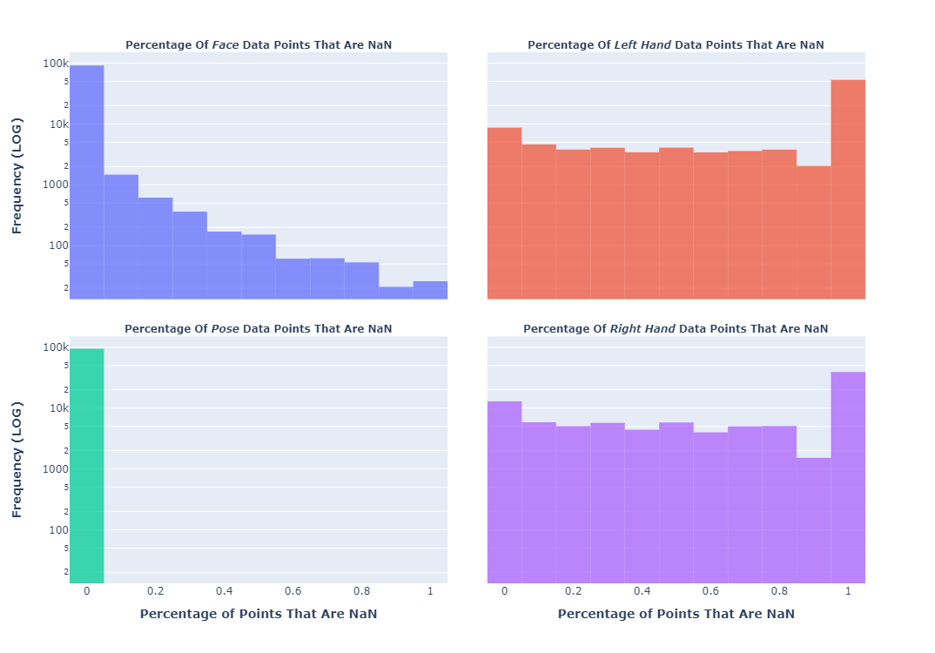
Null Values
The following plot shows the general distributions (independently plotted).
Note the Y axis is log scale.
0.0 (Left Side) - Indicates that no values are missing
1.0 (Right Side) - Indicates that all values are missing
Highlights:
Face points can be NaN although it is less common than in the Hand data
Pose points are never NaN
Left and Right hand distributions are similar but Right Hand is full NaN less than Left Hand

Slide 10
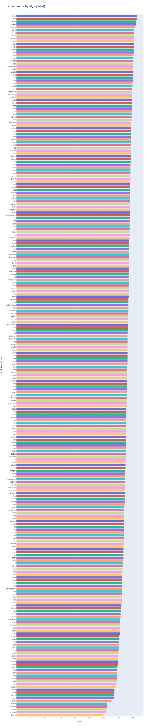
Examine the `sign` Column
Number of Unique Signs: 250
Average Number of Rows Per Sign: 377.908
Standard Deviation in Counts Per Sign: 19.356
Minimum Number of Examples For One Sign: 299
Maximum Number of Examples For One Sign: 415

Slide 11
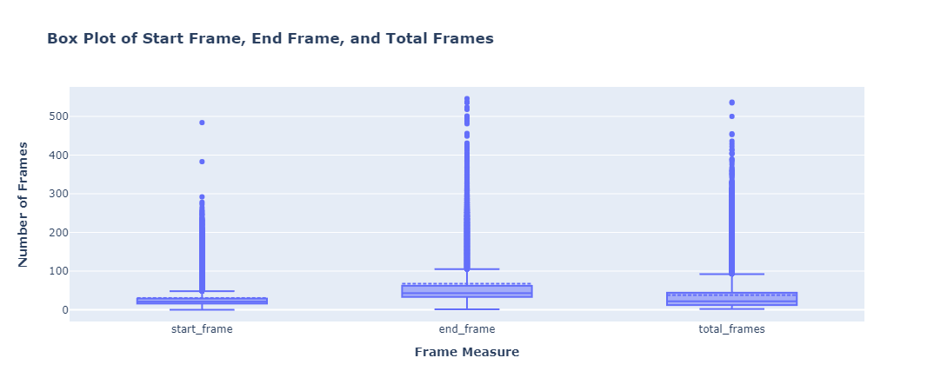
Outlier Analysis
In general, the lower bound does not seem to be enough of an outlier here to be concerning, frame placement and counts always bottom out around 0-2.
The upper bound has some weirdness
The vast majority are within the bottom 90%

Slide 12
Content
Background
Dataset Description
Exploratory Data Analysis
Model Building and Training
Results and Analysis

Slide 13
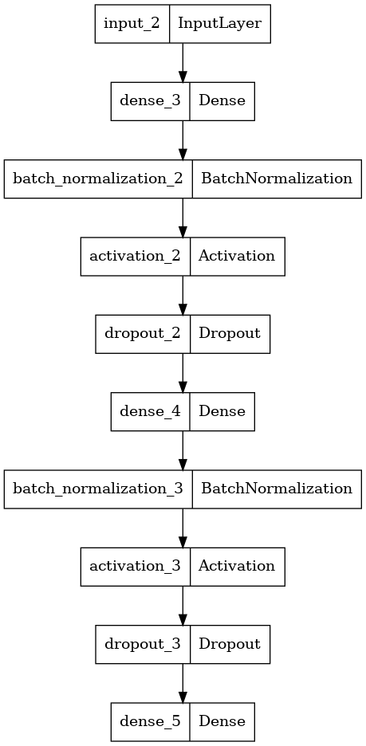
Baseline (Only MLP)
The input data consists of frame sequences, where each frame includes the type and the 2D coordinates [x, y] of 543 keypoints.
The baseline model utilizes only three key frames per sequence (typically the first frame and the two most dissimilar non-zero frames).
These selected frames are flattened into a vector of 3258 features (543 keypoints × 3 frames × 2 coordinates), which serves as the input to a multilayer perceptron (MLP) for training.
The output of the model is the probability distribution over a vocabulary of 250 words.

Slide 14
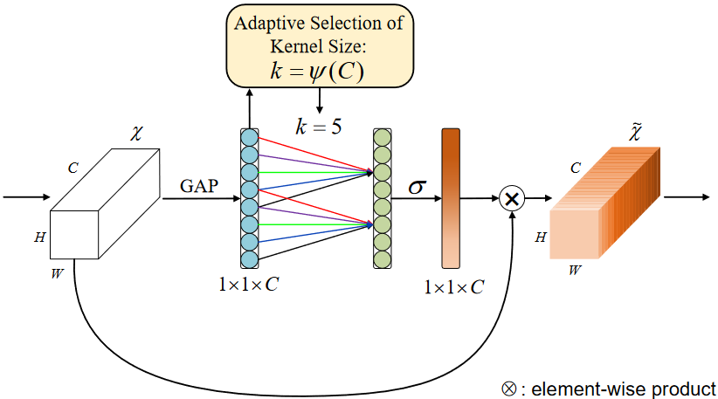
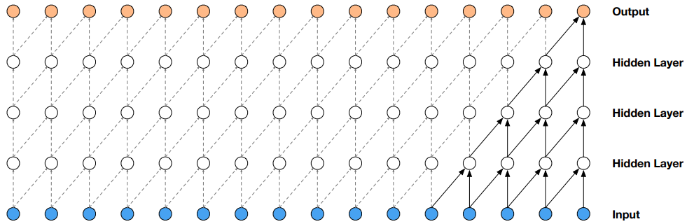
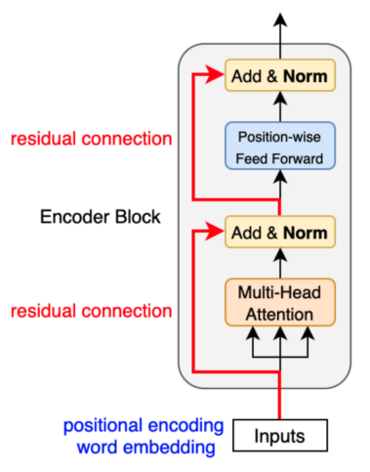
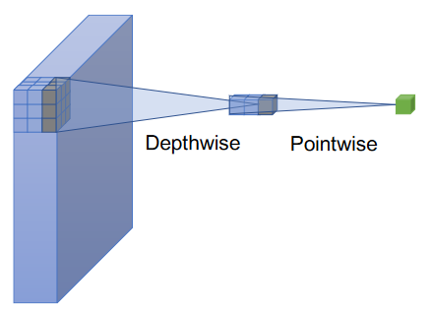
Transformer Architecture
The input data comprises sequences of frames, each containing the type and 3D coordinates [x, y, z] of 118 key points, including landmarks for the hands, eyes, lips, pose, and nose.
To enhance the robustness and generalizability of the model, we applied a comprehensive data augmentation strategy, which included horizontal coordinate flipping, resampling, spatial affine transformations, and temporal cropping.
The model architecture employs an Efficient Channel Attention (ECA) mechanism, Depthwise Separable Convolutional Layers, Causal Convolutional Layers, and Transformer blocks to effectively process the time-series data.

Slide 15
Content
Background
Dataset Description
Exploratory Data Analysis
Model Building and Training
Results and Analysis

Slide 16
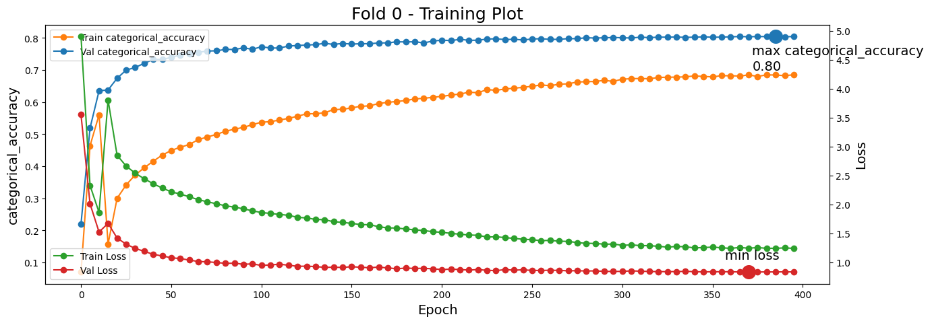
Results
The reason the validation accuracy and loss are better than those of the training set is due to the extensive use of data augmentation on the training set.

Slide 17
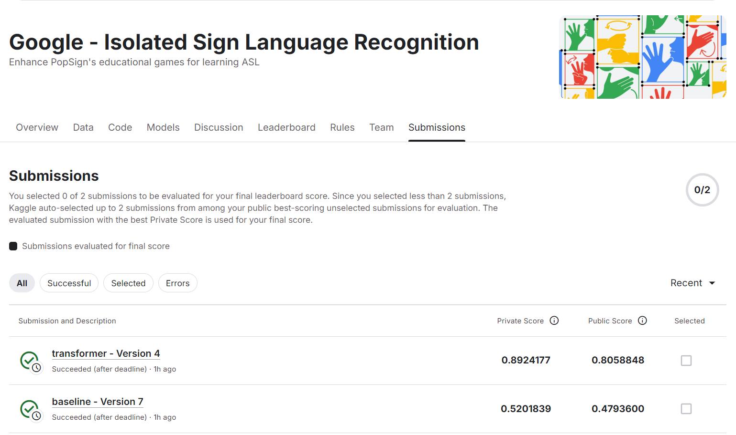
Results

Slide 18
Conclusions
Selected which 118 Landmarks out of 543 Landmarks are important (hands, eyes, lips, pose, and nose.)
Great preprocessing to convert videos of variable length to small fixed length
Implemented state-of-the-art training strategies such as mixed precision training and adaptive weight perturbation to optimize performance.
Demonstrated improved model stability through dynamic learning rate scheduling and weight averaging.
Explore more sophisticated model architectures and data augmentation methods may helpful.
Experiment with additional regularization techniques to further enhance model robustness.
Apply the learned methodologies to related domains such as action recognition and behavior analysis.

Slide 19
References
Ashley Chow, Glenn Cameron, Mark Sherwood, Phil Culliton, Sam Sepah, Sohier Dane, Thad Starner. (2023). Google - Isolated Sign Language Recognition. Kaggle. https://kaggle.com/competitions/asl-signs (Data Source)
Oord A, Dieleman S, Zen H, et al. Wavenet: A generative model for raw audio[J]. arXiv preprint arXiv:1609.03499, 2016.
Guo Y, Li Y, Wang L, et al. Depthwise convolution is all you need for learning multiple visual domains[C]//Proceedings of the AAAI Conference on Artificial Intelligence. 2019, 33(01): 8368-8375.
Wang Q, Wu B, Zhu P, et al. ECA-Net: Efficient channel attention for deep convolutional neural networks[C]//Proceedings of the IEEE/CVF conference on computer vision and pattern recognition. 2020: 11534-11542.
Vaswani A, Shazeer N, Parmar N, et al. Attention is all you need[J]. Advances in neural information processing systems, 2017, 30.

